Slide 1


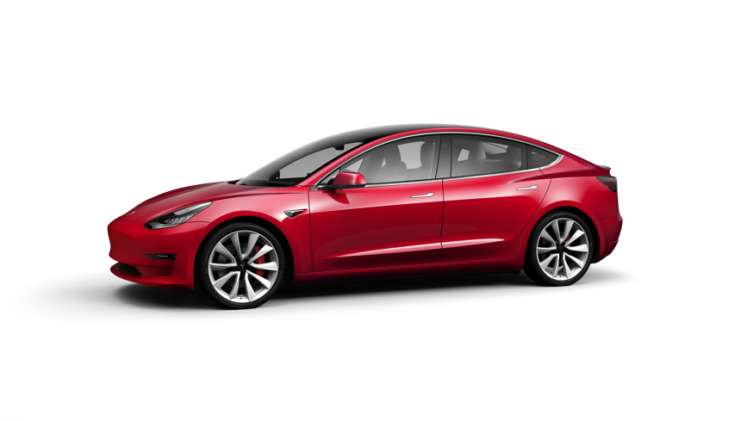
TESLA MODEL E
TF 5033 Electric Vehicle Energy System
Bernardus Rendy - 13317041

Slide 2
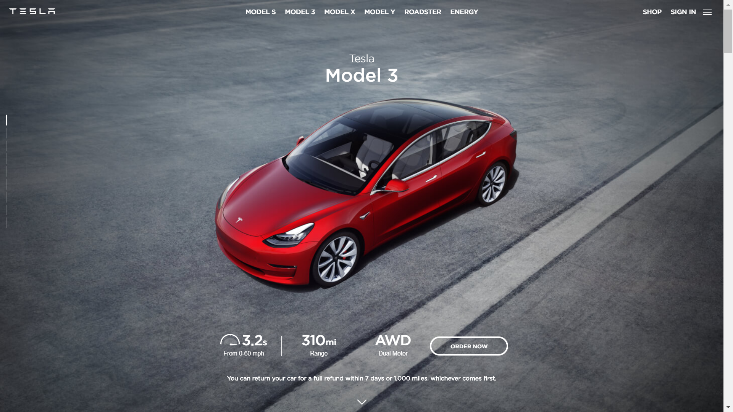
Notes:
Tesla Model 3 is the ultimate goal of tesla business plan, The third phase of tesla production plan, after model X, model S, and tesla roadster. It has 310 miles range for the performance and long range, and 240 miles for the standard range plus (slow acceleration as well, RWD).

Slide 3
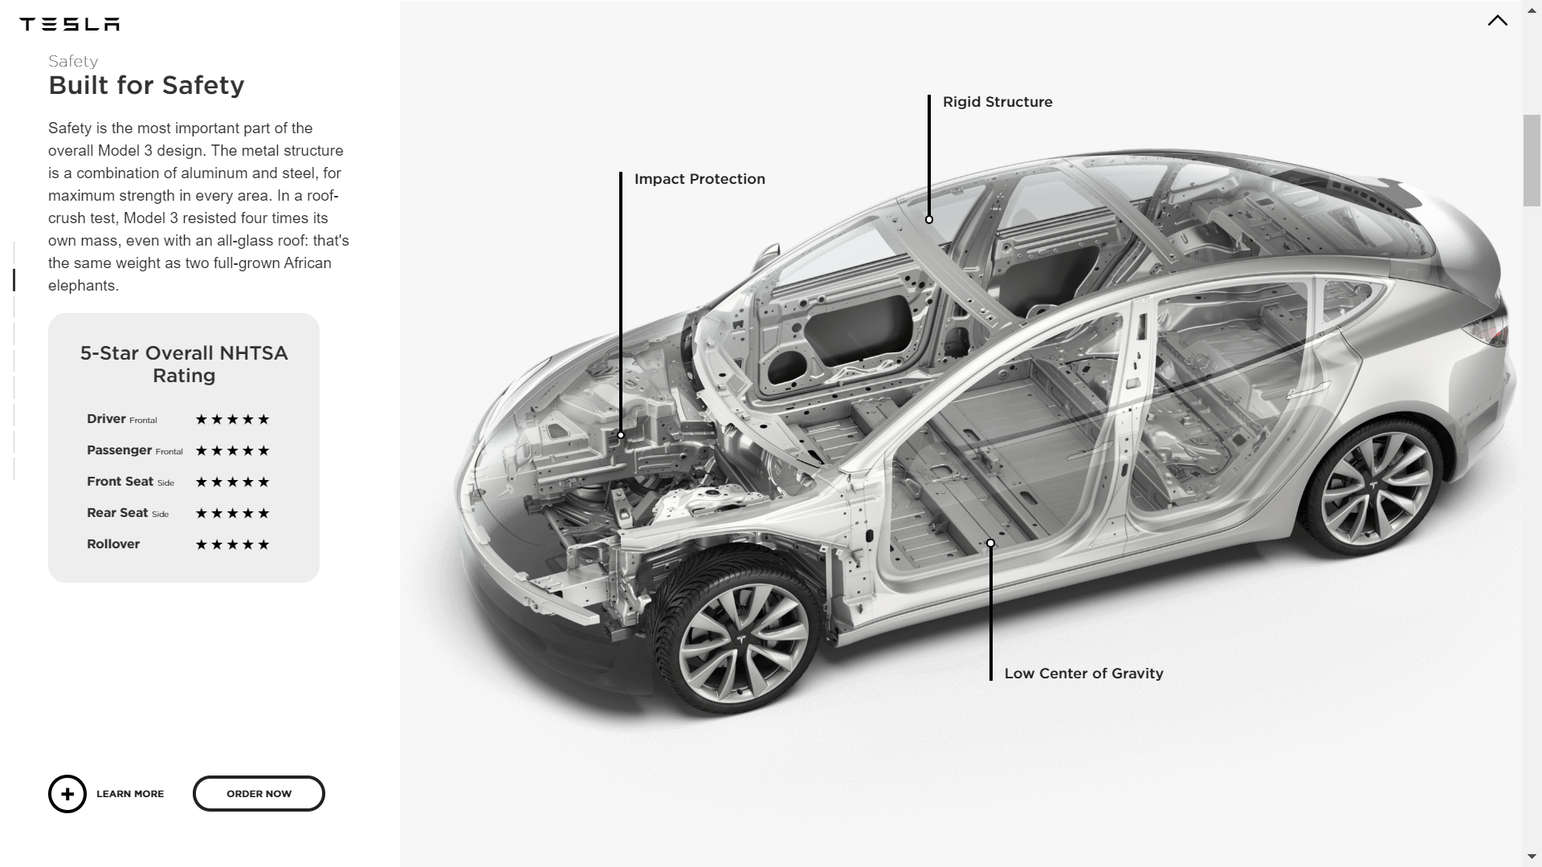
Notes:
Low CoG to counter imbalance and prone to roll over in sharp or emergency turn.

Slide 4
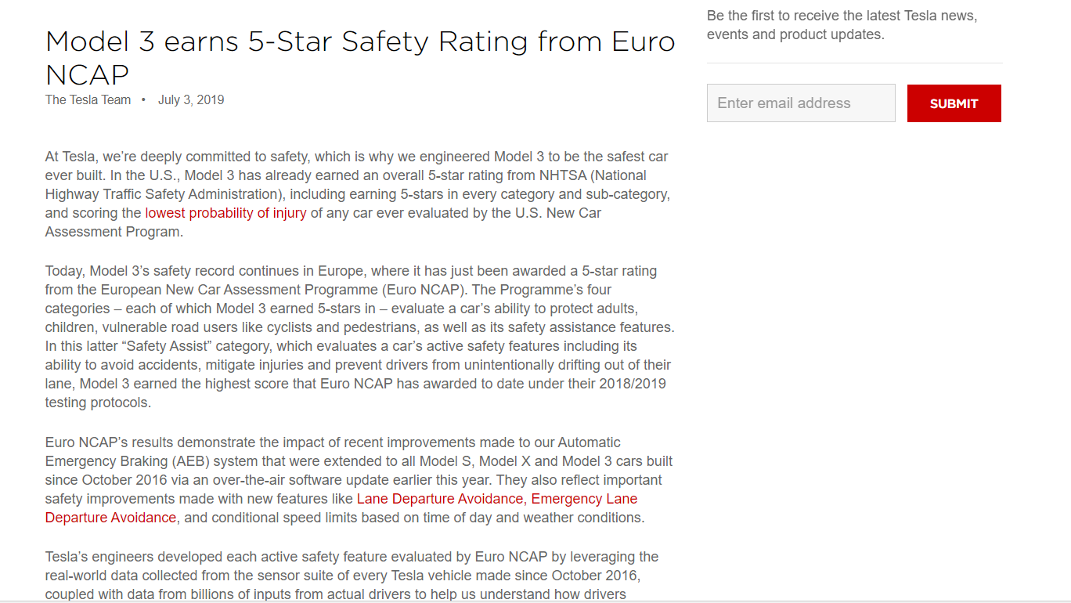

Slide 5
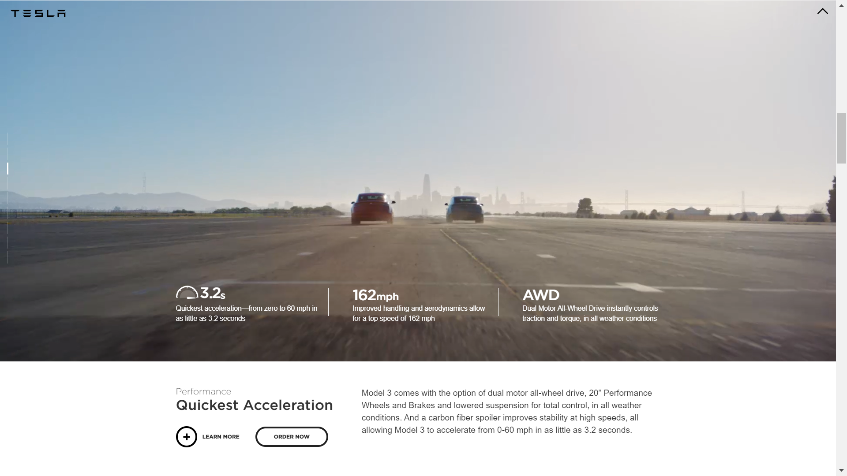

Slide 6
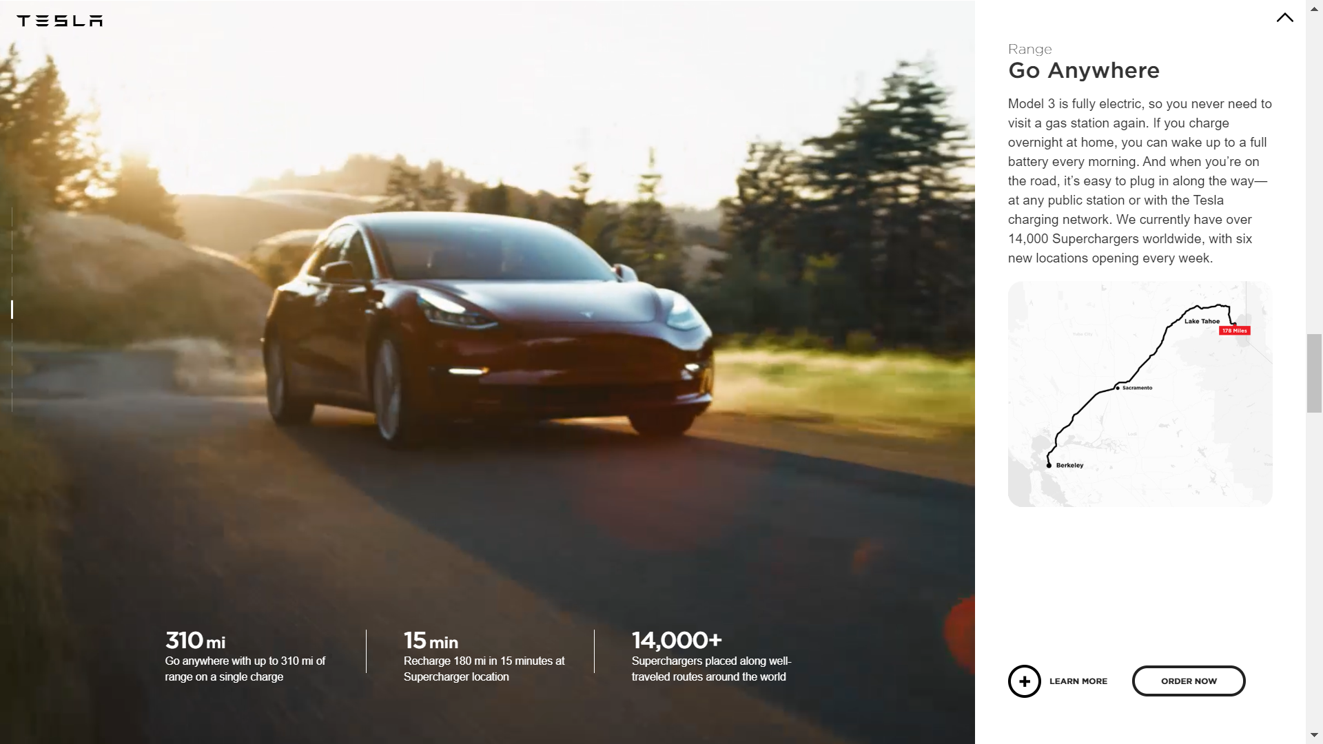
Notes:
310 miles = 499 km

Slide 7
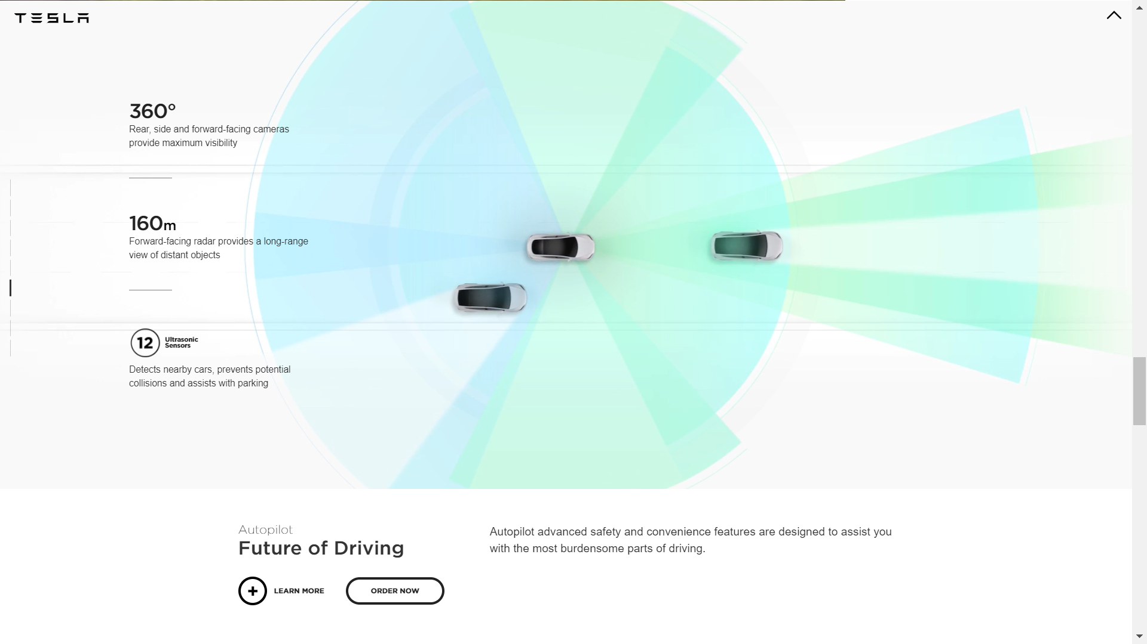

Slide 8
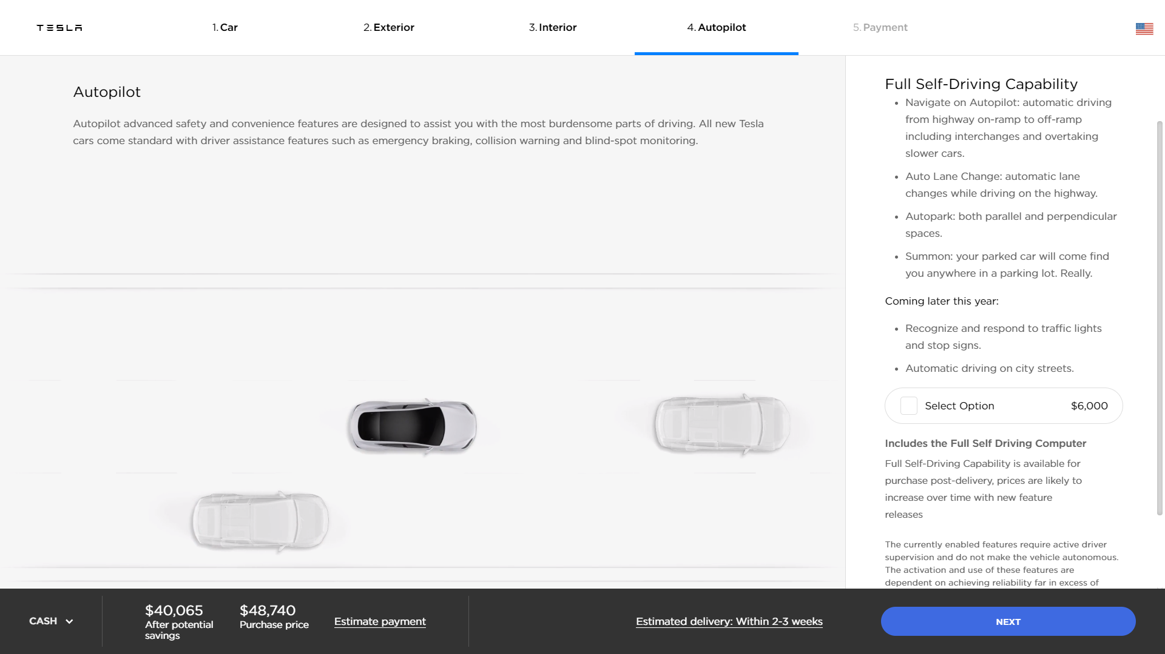
Notes:
The Tesla Model 3 will come standard with the Autopilot hardware and will use that hardware for safety features like emergency braking, but you will have to pay extra for activation of the convenience features such as Autopark, Summon, and Autosteer driving.

Slide 9
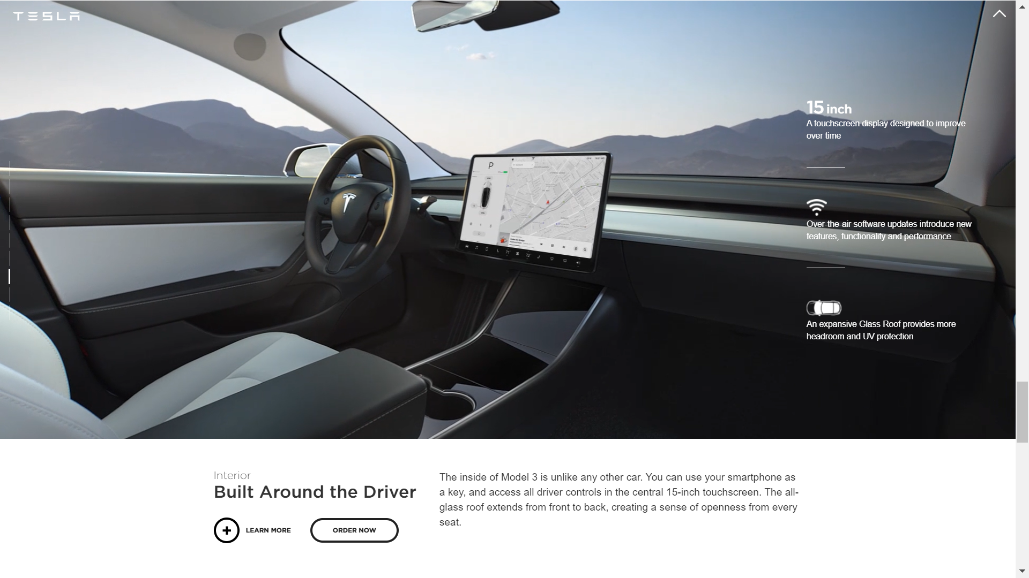

Slide 10
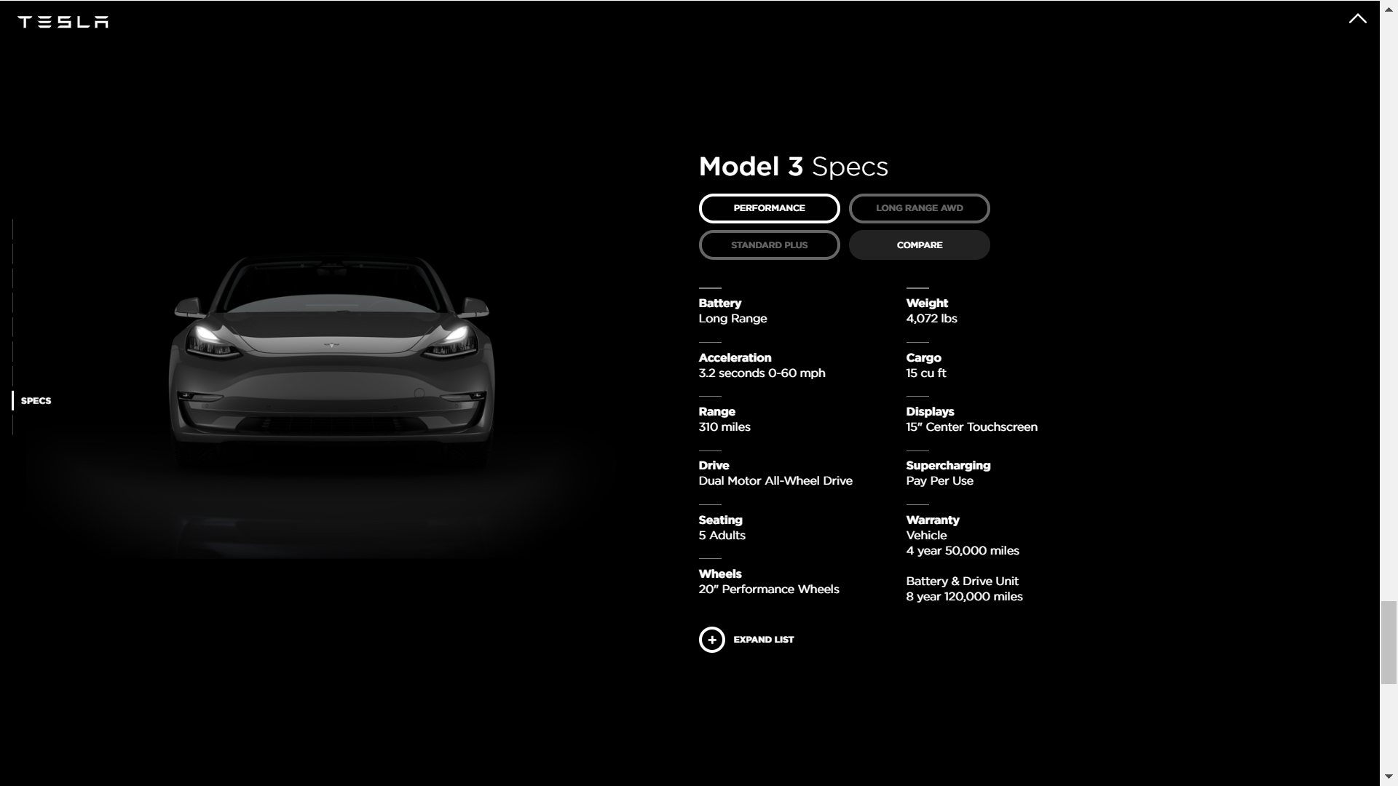

Slide 11
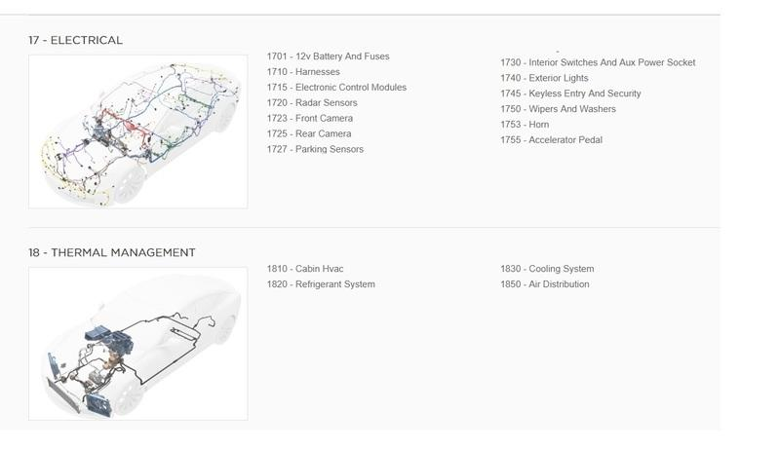
UTILITIES
TESLA

Slide 12
TESLA APP
TESLA

Slide 13
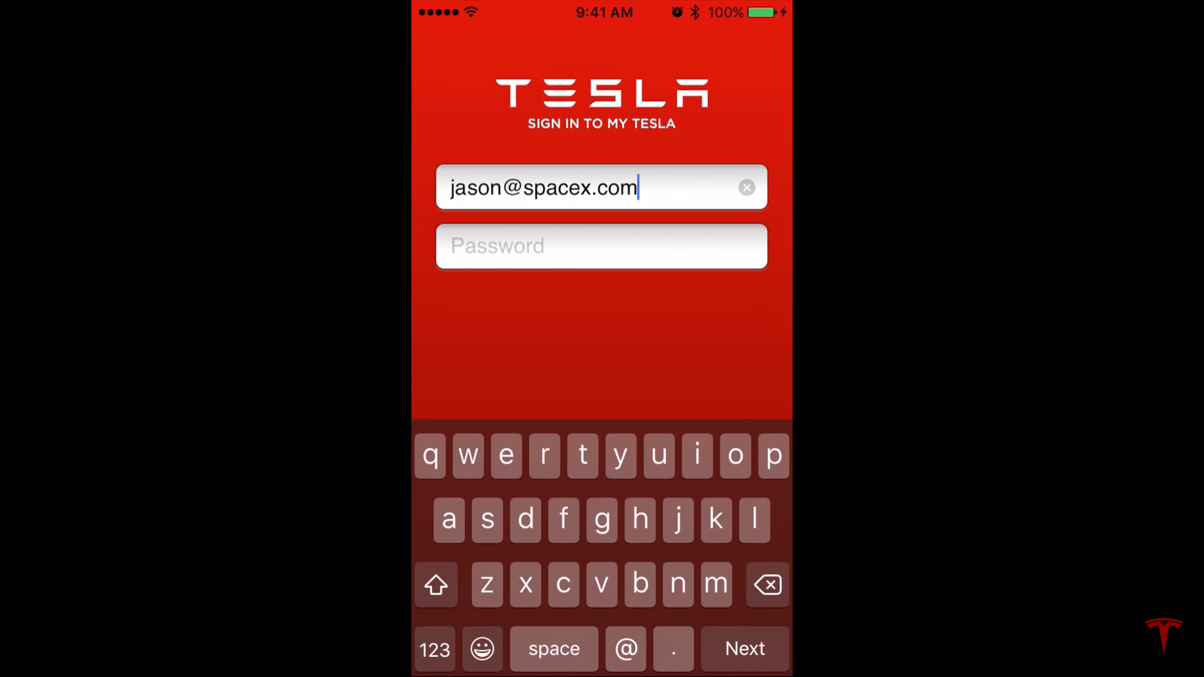
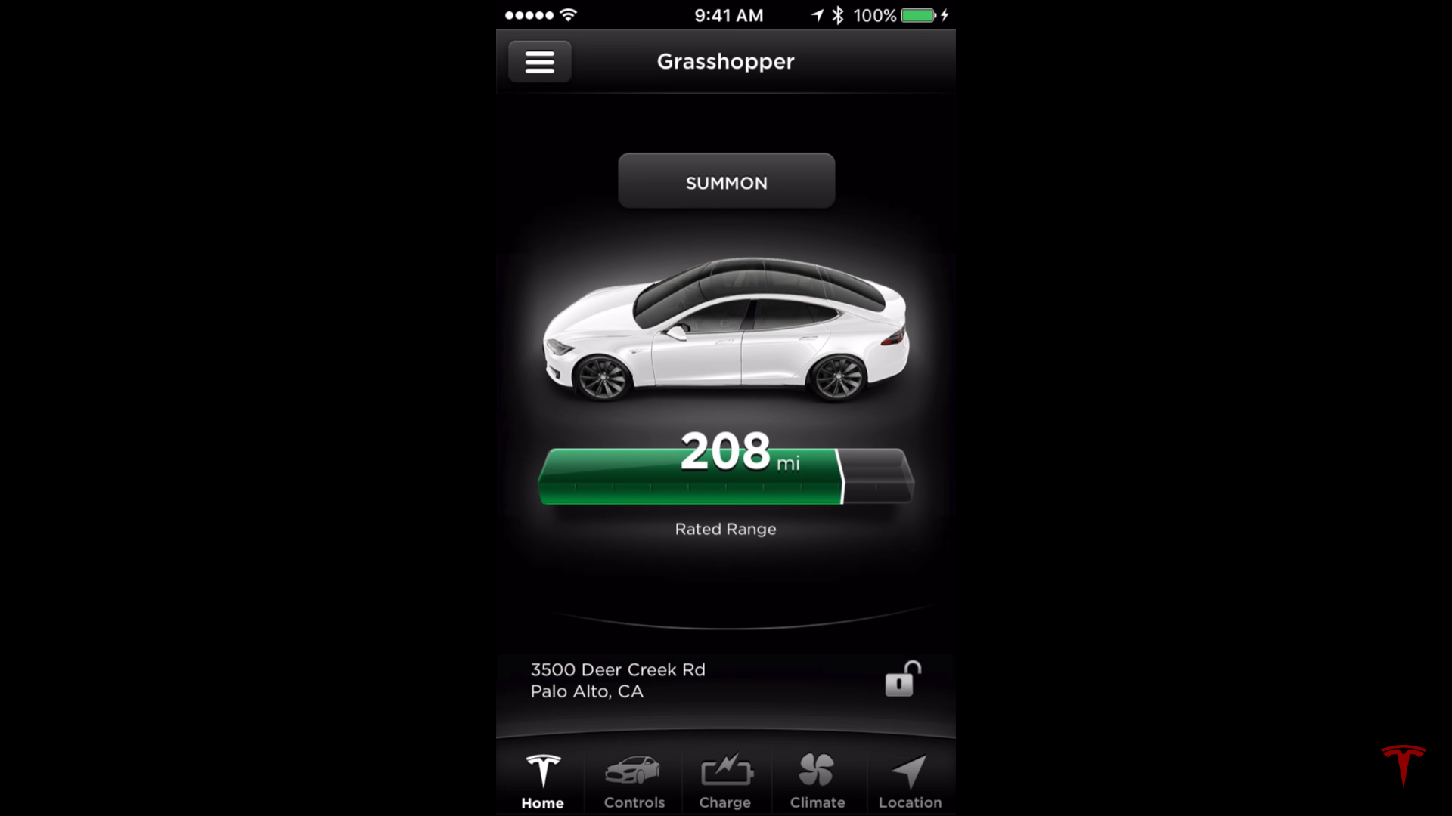
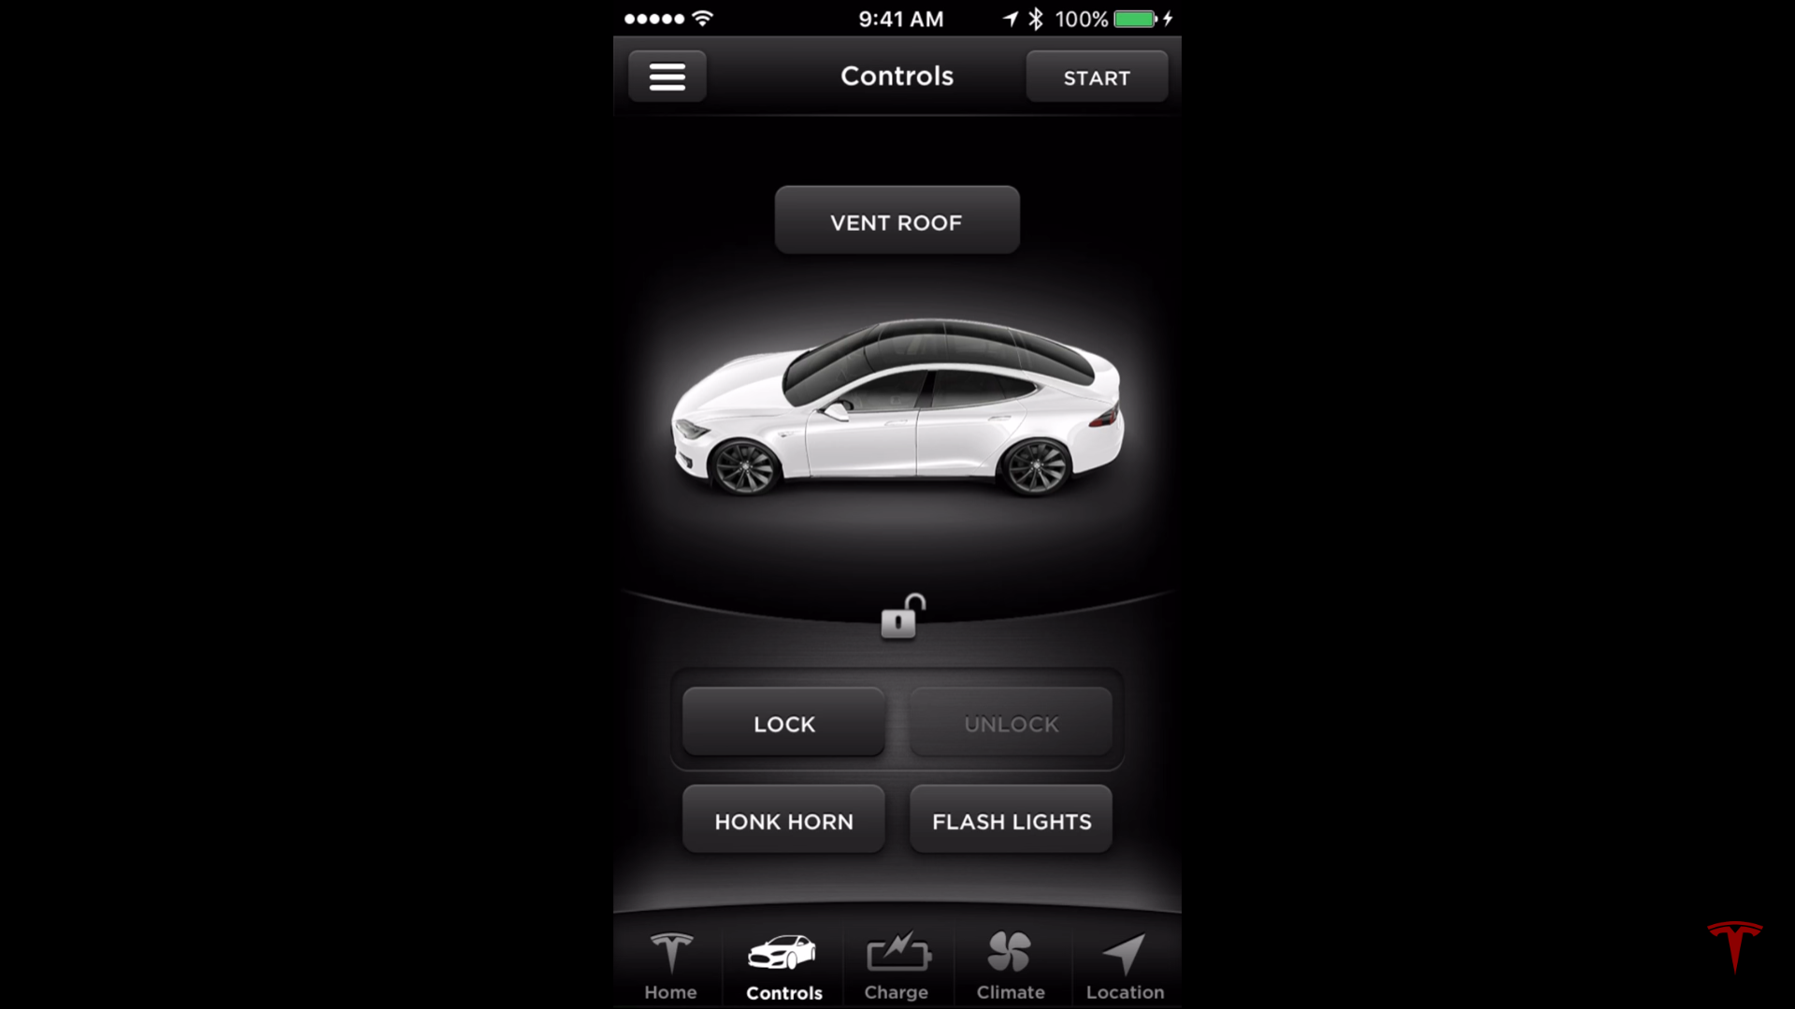
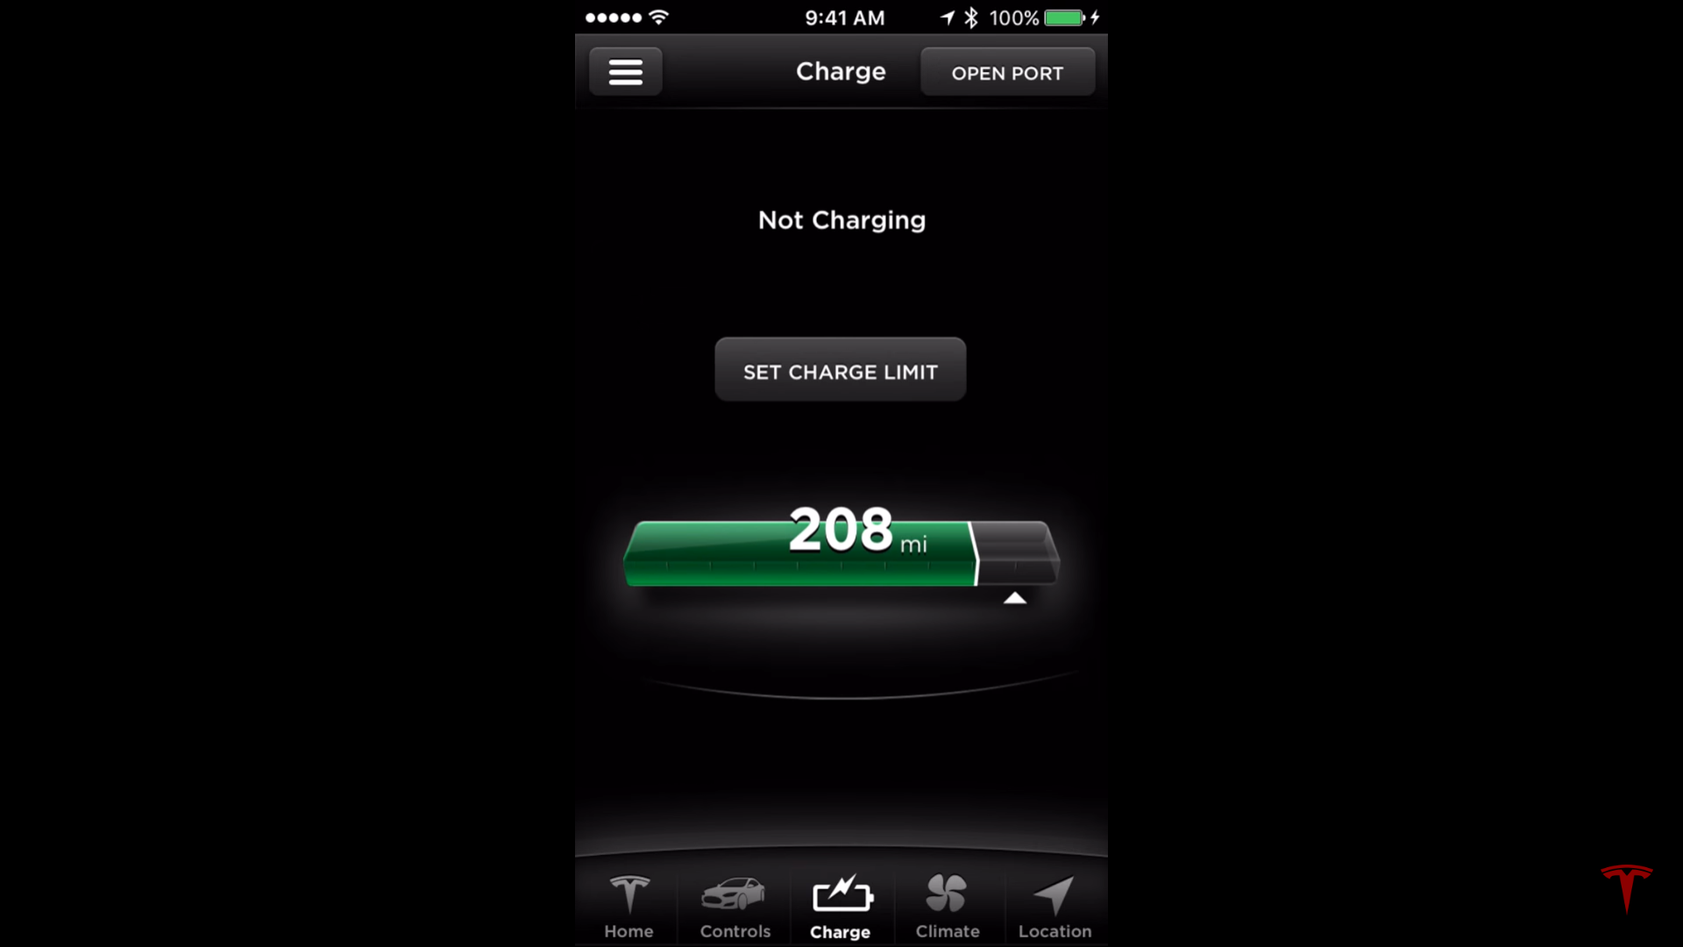
TESLA APP
TESLA

Slide 14
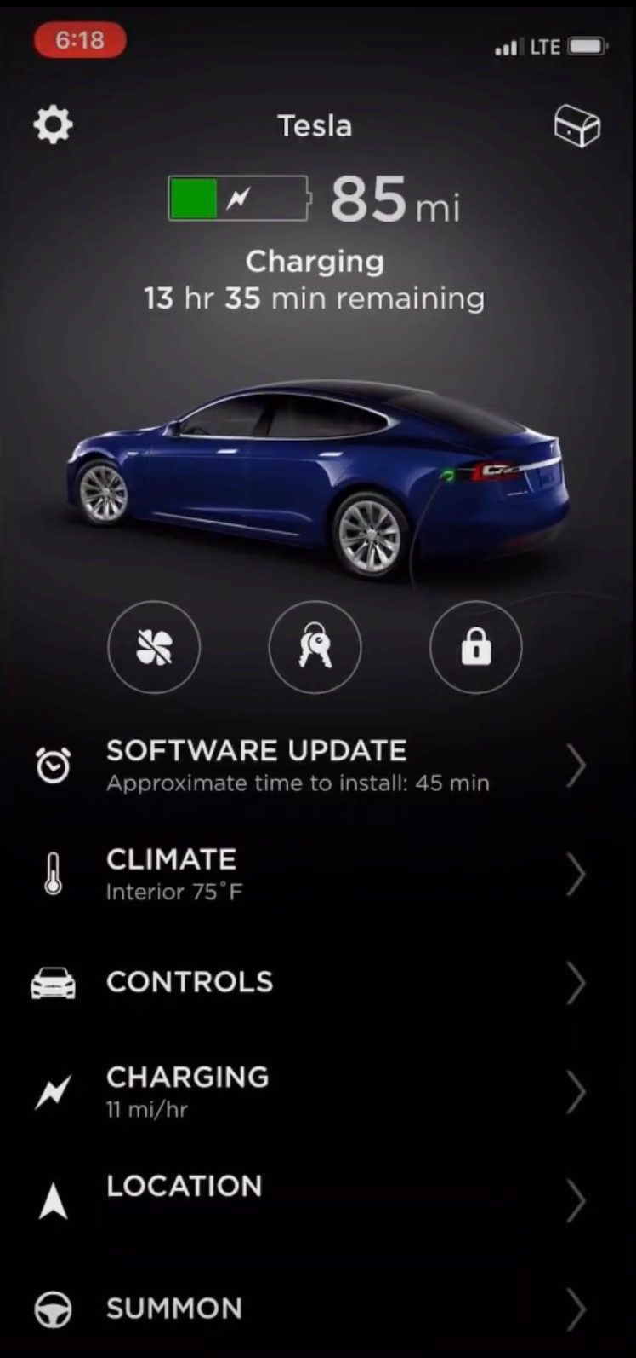
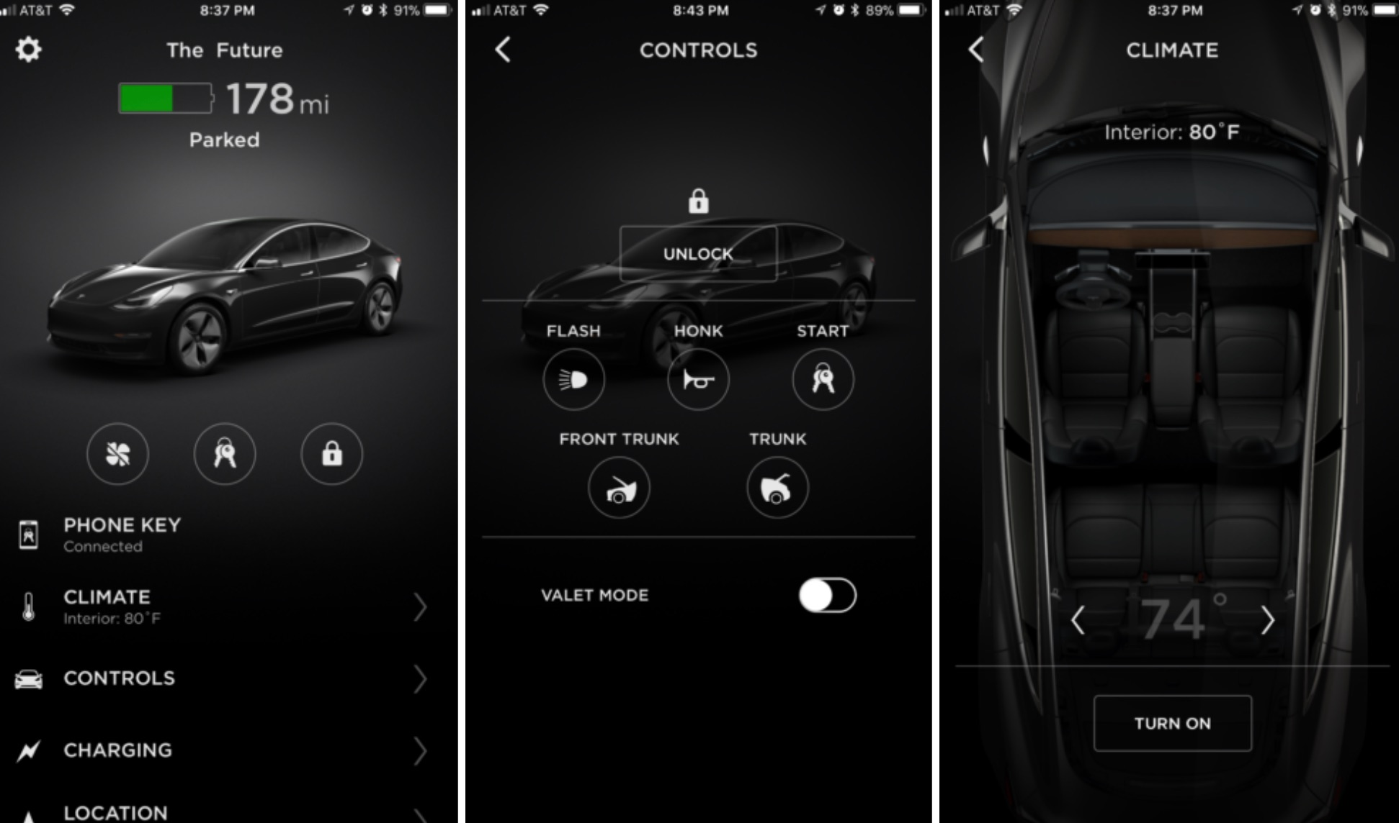
TESLA APP
TESLA

Slide 15
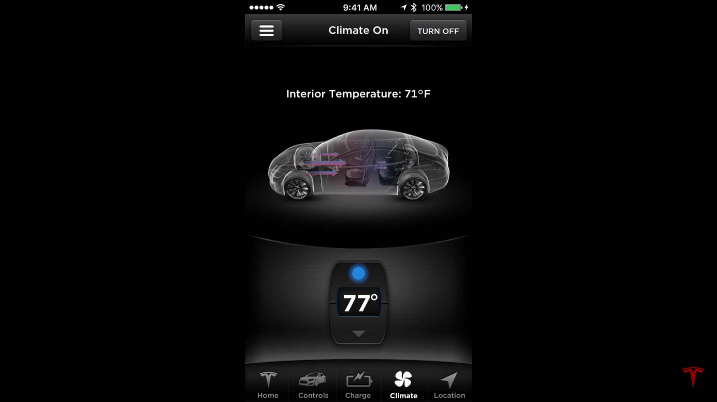
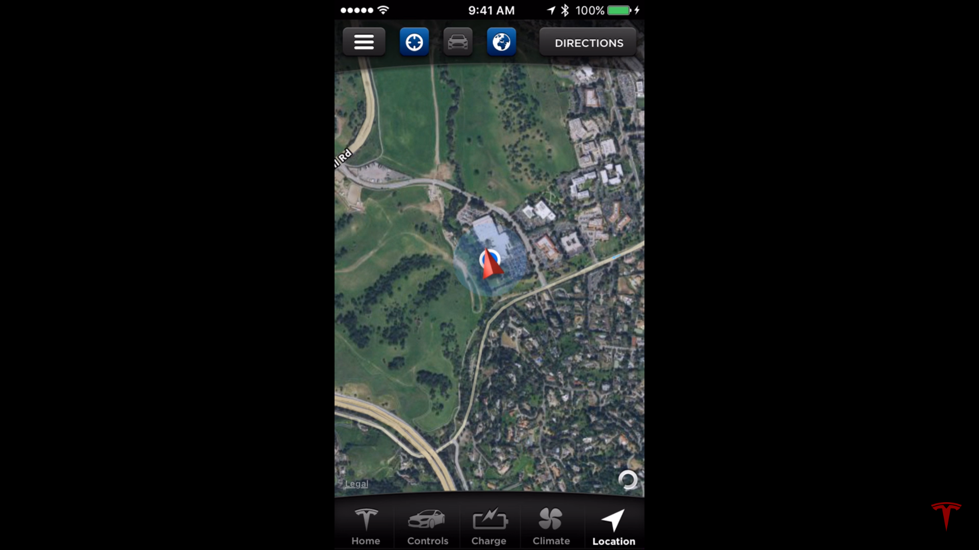
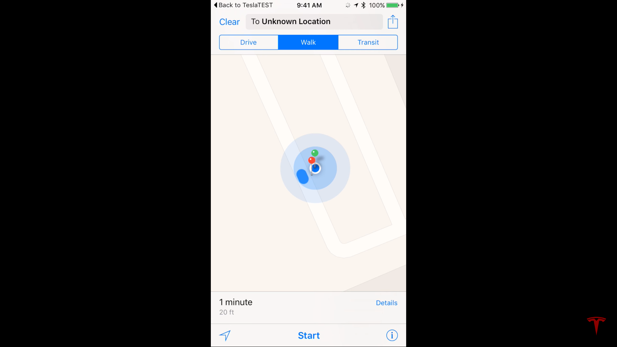
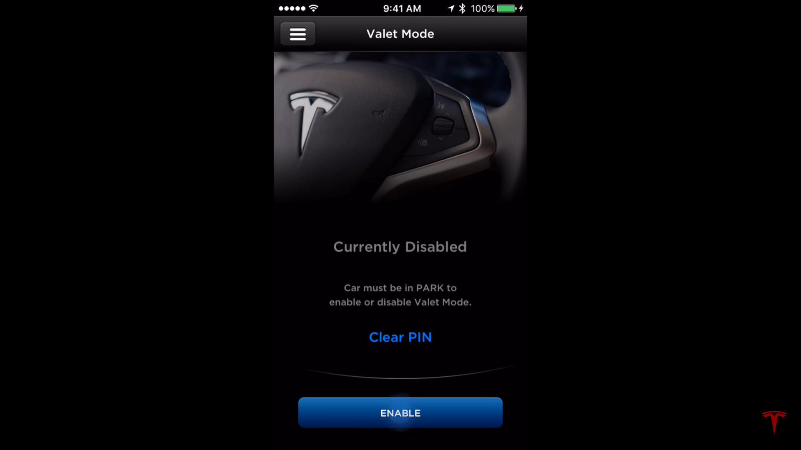
TESLA APP
TESLA

Slide 16
TESLA MODEL E SMART GRID ARCHITECTURE MODEL
TESLA

Slide 17
COMPONENT LAYER
Ultra high strength steel reinforcement
Modified Suspension Chassis
Three phase power steering motor
Dual ECU
ESC Hydraulic Stability Control
Wheel Speed Sensor
Steering Angle Sensor
Yaw Rate Sensor
Anti-Lock Braking System (ABS)
Electronic Brake-Force Distribution (EBD)
Traction Control System (TCS)
2 PMSRM Induction Motor
650V SiC MOSFET Based Inverter
Autopilot Computer
Ultrasonic Sensors
Forward Facing and Rear View Camera
GPS
RADAR Sensors
Park Distance Sensors
Front Body Controller (ST SPC56EC74L8)
Rear Body ECU
2170 Cell Based NCA Battery Pack
Battery Pack Stabilizer (Vibration reduction)
Multi-Channel and Bi-Directional BMS
Battery Voltage and Current Sensors
DC-DC Power Conversion System (TMS320F28377DPTPQ)
Tablet Based All-in-one User Interface with Hidden Screen for Vehicle Diagnostics
Tesla Mobile Application
Transmitter Remote Keyless Entry
Receiver Remote Keyless Entry
Spline membrane cooling tube
Distributed thermal sensors
Heat exchanger
Cabin HVAC
Front Body Controller
Central Body Controller
Rear Body Controller
Cloud Database
Onboard Media Control Unit
TESLA

Slide 18
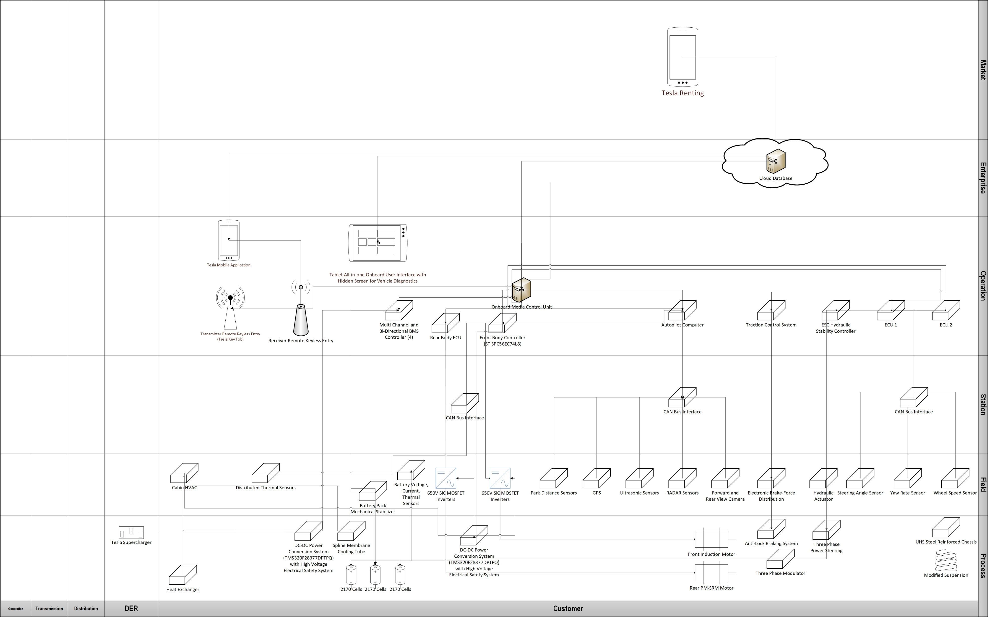
COMPONENT LAYER

Slide 19
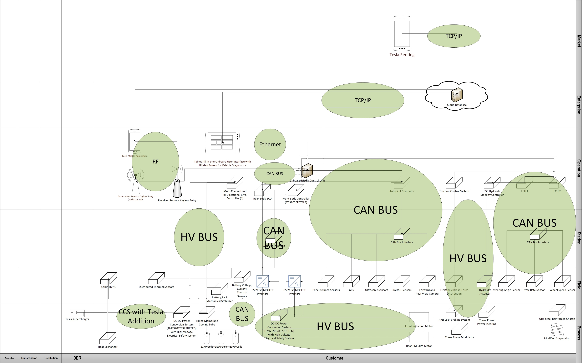
COMMUNICATION LAYER

Slide 20
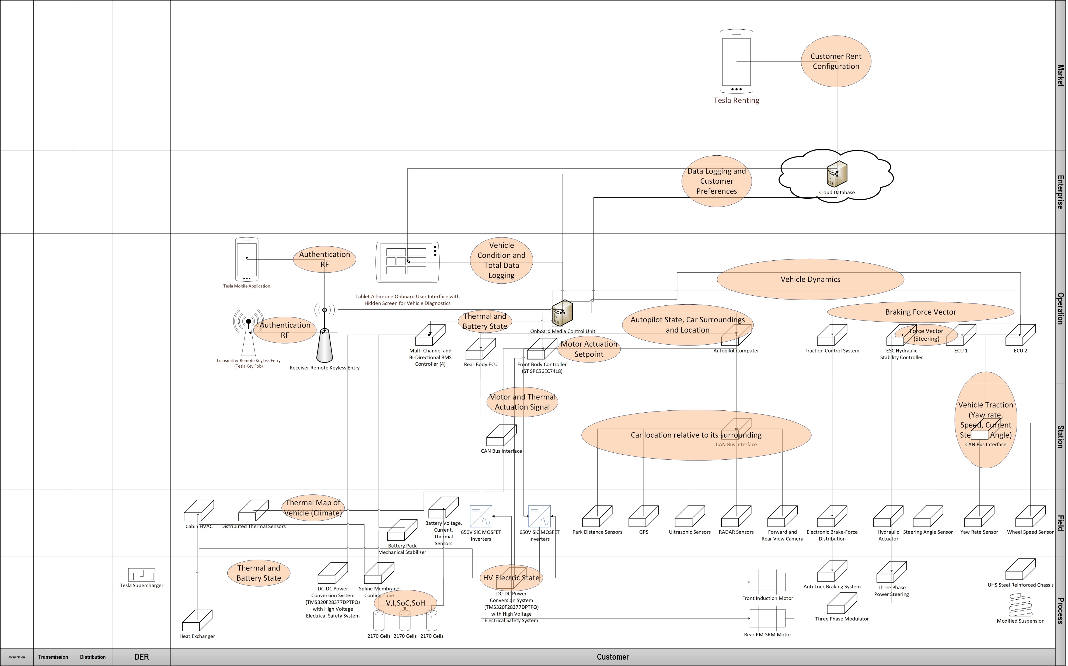
INFORMATION LAYER

Slide 21
fUNCTION LAYER
Mechanical Safety, Autopilot, and Drive Train Control System
Long Lifetime, Long Range, Fast Charging Battery Energy Storage System
User Centered Interface
Energy Efficient Vehicle Climate Control
TESLA

Slide 22
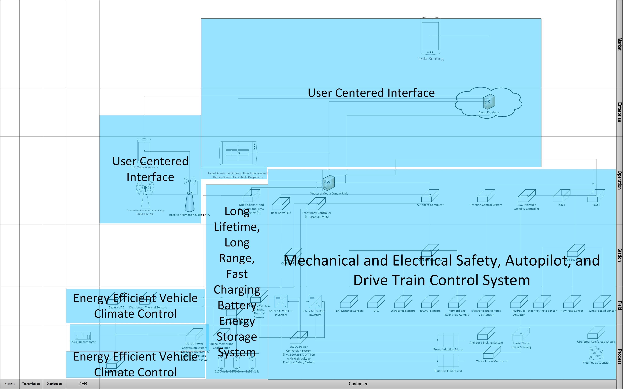
FUNCTION LAYER

Slide 23
BUSINESS LAYER
Rent Service using Autopilot for Customers
Big Data Business Intelligence
Customer’s Safety
Remote Operation and Diagnosis
Long Range and Long Lifetime
Customer’s Time Efficiency
High Performance Driving
TESLA

Slide 24
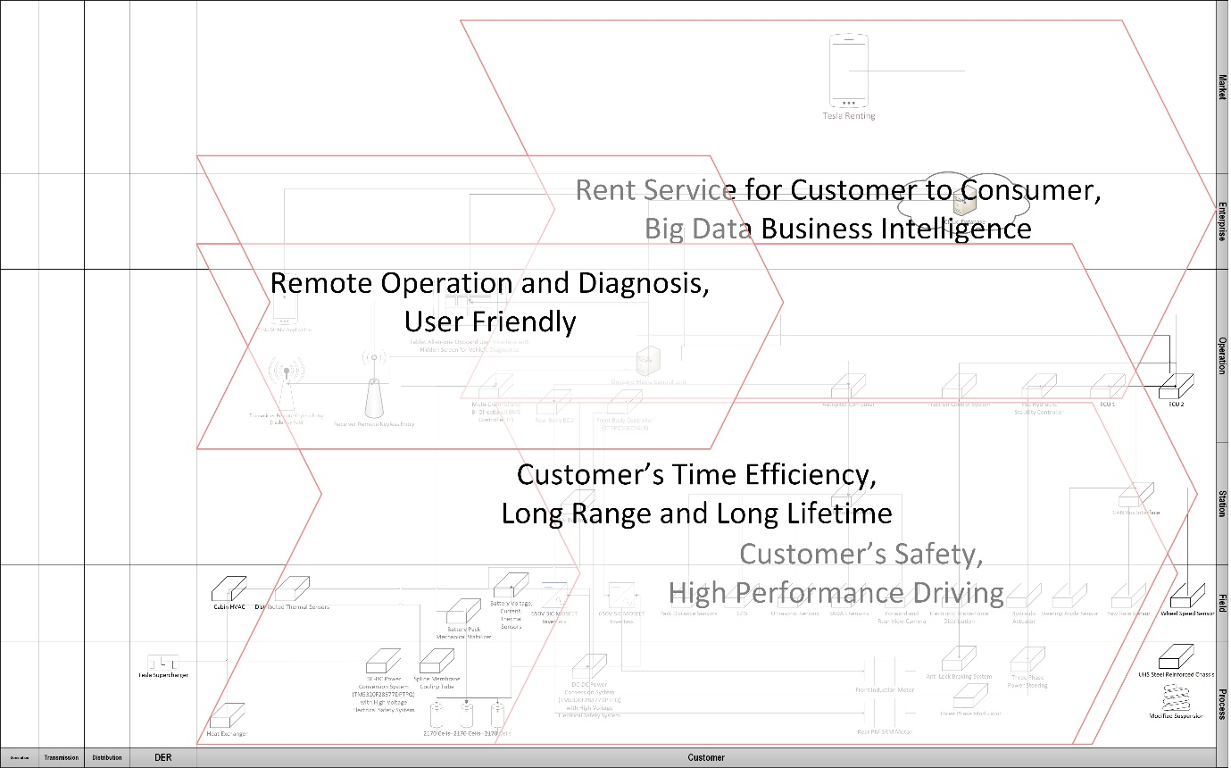
FUNCTION LAYER

Slide 25
REFERENCES
Goodarzi, Gordon A._ Hayes, John G - Electric powertrain _ energy systems, power electronics & drives for hybrid, electric & fuel cell vehicles-John Wiley & Sons (2018)
(US9527403B2) Charging station providing thermal conditioning of electric vehicle during charging session https://patents.google.com/patent/US9527403B2/en
(WO2019006204) Multi-channel And Bi-directional Battery Management System https://patentscope.wipo.int/search/en/detail.jsf?docId=WO2019006204
(US20190280334) NOVEL BATTERY SYSTEMS BASED ON TWO-ADDITIVE ELECTROLYTE SYSTEMS INCLUDING 1,2,6-OXODITHIANE-2,2,6,6-TETRAOXIDE https://patentscope.wipo.int/search/en/detail.jsf?docId=US251449154&tab=NATIONALBIBLIO
(US20110212356A1) Extruded and Ribbed Thermal Interface for use with a Battery Cooling System https://patents.google.com/patent/US20110212356A1/en
(US7841431B2) Electric vehicle thermal management system https://patents.google.com/patent/US7841431
https://www.tesla.com/model3
https://www.teslarati.com/tesla-high-speed-wiring-full-self-driving-safety-patent/
TESLA

Slide 26
REFERENCES
https://www.inverse.com/article/50894-tesla-model-3-charging-without-charger
https://cecas.clemson.edu/cvel/auto/systems/regenerative_braking.html
https://www.researchgate.net/figure/Overall-structure-of-the-regenerative-and-hydraulic-blended-braking-system_fig1_268389110
https://ev-database.org/car/1138/Tesla-Model-3-Long-Range-Dual-Motor#charge-table
https://www.youtube.com/watch?v=QW3PmRp7EK8
https://www.teslarati.com/tesla-model-3-steering-drivetrain-suspension-secrets-revealed/
https://www.carthrottle.com/post/electronic-power-assisted-steering-how-does-it-work/
https://electrek.co/2019/04/13/tesla-model-3-longevity-claims-elon-musk/
https://tsportline.com/blogs/owners-guide/the-tesla-model-3-wheel-guide
https://electrek.co/2017/08/24/tesla-model-3-exclusive-battery-pack-architecture/
https://seekingalpha.com/article/3983102-teslas-gigafactory-christmas-july
TESLA

Slide 27
REFERENCES
https://www.grin.com/document/341486
https://www.youtube.com/watch?v=vlVFhT-DjnI
https://www.youtube.com/watch?v=vxMvegqVPbg
https://insideevs.com/news/338500/first-look-at-hidden-screens-in-tesla-model-3/
TESLA

